Slide 1
INTERACTION INTELLIGENCE
Agent X
AUTOMATED QA/QC + SPEECH ANALYTICS
OCTOBER 2024

Slide 2



What is HGS – AgentX “Interaction Intelligence”
Interaction Intelligence harnesses Language Model (LLM) and Machine Learning (ML) capabilities tailored for call center environments, enabling businesses to glean valuable insights and conduct rigorous QA/QC on Customer interactions.
Key Features
A robust analysis tool for extracting actionable insights, ensuring the addressal of critical business challenges.
Daily Insights based on API-based data extraction from the source systems.
Insights to improve sales, analyze marketing campaigns, reduce operational costs, and drive Agent training.
Affirmative impacts to topline & bottom-line.
Fully Automated QA monitoring via configurable questionnaires, using pre-defined templates and fine-tuned data models.
Dashboard on traceable key performance indicators.
Capability to analyze 100% of interactions.
Multi-language support. Reports available 24x7.
Transcripts encrypted for security, with PII redacted to protect privacy.
Interaction Insights
Automated QA/QC
40+ Metrics + Custom metrics
PII masking + Encryption
Sales Pitch Analysis
Call Driver analysis
Topics & Keywords
Sentiment, Analysis
Compliance Management
CSAT and Sales Insights
Quality vs Sentiment
Customer Retention Analysis
Multi-language support
Dashboards & Reports with Insights
Notes:
To streamline the automation SOP for P&P requires few modifications:
Currently, the LLM isn't provided with a context (e.g., a policy document) for reference during call assessments. As a result, the assessment relies solely on the question statements.
Providing a detailed context document can enhance scores. In the absence of such documents, ensuring the question statements align closely with Astound policy expectations can also improve scores.
Key Insights:
Potential impact on operational cost based on sentiment, quality, and average duration trend.
Potential impact on CSAT based on quality attributes trend.
Leaderboards for training need and dataset identification.
Top Agents on Quality Dashboard for training dataset/content
Bottom Agents for immediate training need

Slide 3
Value HGS delivers in comparison to Manual QA solutions
HGS – Automated Solution
Manual Solution
Ability to automated 100% of QA evaluation process
Less than 24 to 36hrs. Turnaround time for QA evaluation forms
Actionable insights with 30+ speech attributes
Dashboard detailing Interaction insights by persona.
Reporting includes insights across Quality, Sales, Training, Operations, & Marketing
Secured, Compliant and automated process using API Integration
Multi-language support
Less than 2-3% of calls being QA’ manually
Up to 7 days of QA evaluation report turnaround time
No call Analytics: Call drivers reports
No actionable insights with speech attributes
Limited opportunities to drive training needs
Manual process with limitations
~100% THROUGHPUT
RESULTS ACROSS VERTICALS
OPERATIONAL INSIGHTS
REDUCED TIME TO ACTION
AGENT TRAINING
Overall throughput of ~100%, in contrast to 2-3% manual throughput.
Insights across verticals such as Quality, Sales, Operations, Marketing, etc.
Insights on operational gains and opportunities of efficiency.
Reports published in with lesser turnaround time, in contrast to 7-8 days for manual processes.
Identify specific topics & area of improvement tailored for Agents/Teams.
HGS Brings In
Notes:
To streamline the automation SOP for P&P requires few modifications:
Currently, the LLM isn't provided with a context (e.g., a policy document) for reference during call assessments. As a result, the assessment relies solely on the question statements.
Providing a detailed context document can enhance scores. In the absence of such documents, ensuring the question statements align closely with Astound policy expectations can also improve scores.
Key Insights:
Potential impact on operational cost based on sentiment, quality, and average duration trend.
Potential impact on CSAT based on quality attributes trend.
Leaderboards for training need and dataset identification.
Top Agents on Quality Dashboard for training dataset/content
Bottom Agents for immediate training need

Slide 4









“Interaction Intelligence” Process Overview
PII/PCI masking & encryption
NLU/NLP based speech recognition and transcription
Actionable insights on sales, marketing, operations, compliance, & training
Audio quality enhancement
Secure RBAC based access to dashboards
Sentiment, Sales Pitch, Customer retention analysis & more
Manual audit for continuous model fine-tuning
API integration for Call/Chat interaction data
LLM-based Automated QA/QC & Compliance checks
Notes:
Benefits:
• Ability to automate 100% of QA evaluation process
• Less than 24 to 36hrs. turnaround time for QA evaluation forms
• Actionable insights with 30+ speech attributes
• Multi-langauge support
• Improved call KPIs
• Improvement in FCR, CX, NPS, CSAT
• Reduction in ACW, TAT, AHT, ATQ
Data Security and Privacy:
• Data Encryption and Privacy ensures Transcripts are encrypted for security, with PII redacted to protect privacy. Following output generation, raw files are deleted to ensure data minimization.
• Data Retention and Access Control ensures outputs for calls older than 90 days are automatically cleared, maintaining data hygiene. Geographical data residency is enforced, preventing data from leaving the specified region.
• Secure Access ensures outputs are accessible exclusively through VPN-based authorization, ensuring that only authorized personnel can access sensitive data.

Slide 5
Project Brief & Next Steps
Project Brief
Objectives
Expected Outcomes
Project Stages
Identify risk and compliance breaches.
Process automation to score compliance, CSAT, Sales.
Detailed dashboards with insights on training needs, operational costs, and sales drivers.
Requirement assessment
Working Session with Ops
Phase1 (limited calls)
Fine-tuning based on results & necessary dev
Complete Implementation
Automate manual compliance checks using speech analytics.
Generate insights across verticals like Sales, CSAT, and Sales.
Automate compliance via speech analytics and LLM-based analysis.
Score for Compliance, CSAT, Sales.
Create dashboards with agent-level insights.
✓
Working Session
Phase 1
Assessment & Fine-Tuning
Next Steps
Assessing q/a adaptability
Gaining needed details from Ops
Setup processes for QA/QC
Produce results for ~200 calls
Assess the produced results
Fine-tune model accordingly

Slide 6
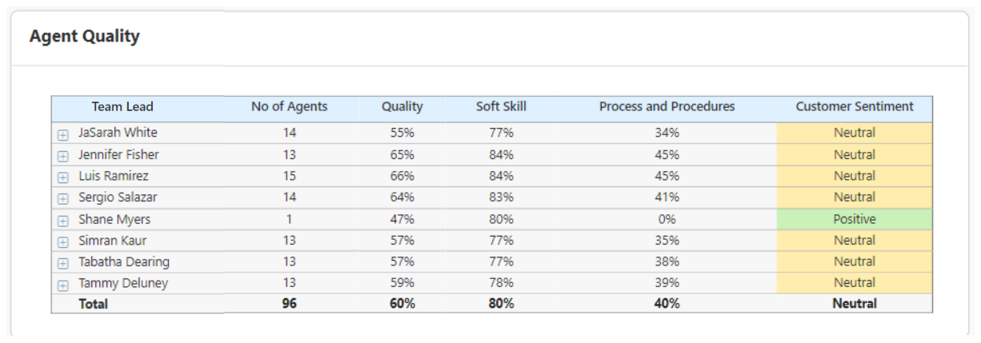
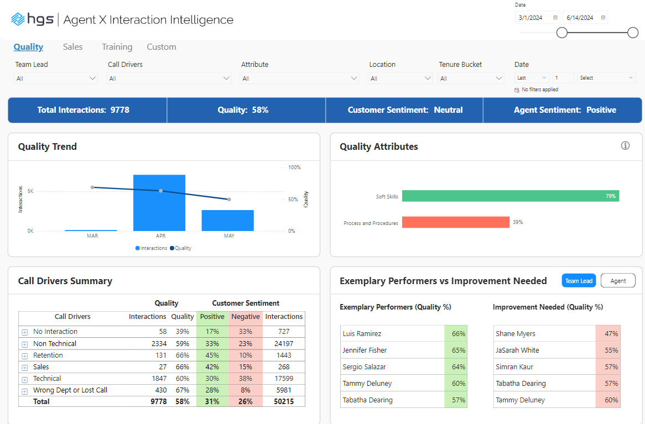
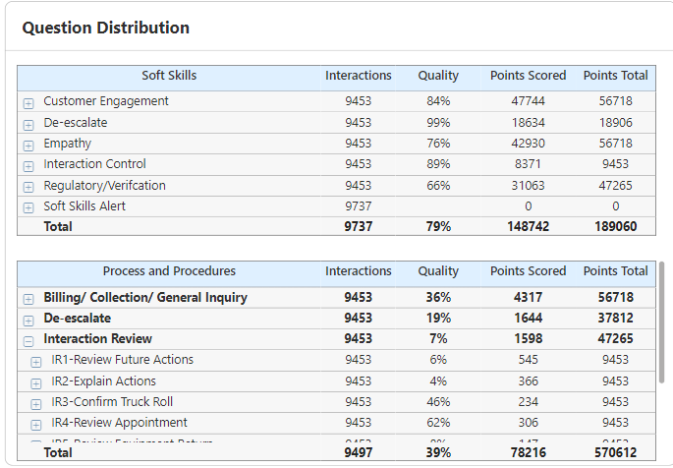
Dashboards for Deep Insights
Detailed Agent-wise Distribution
Trends & Summarized view

Slide 7
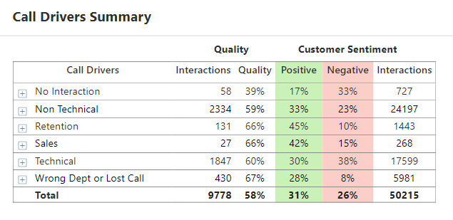
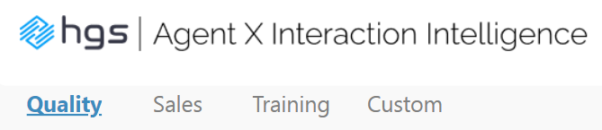
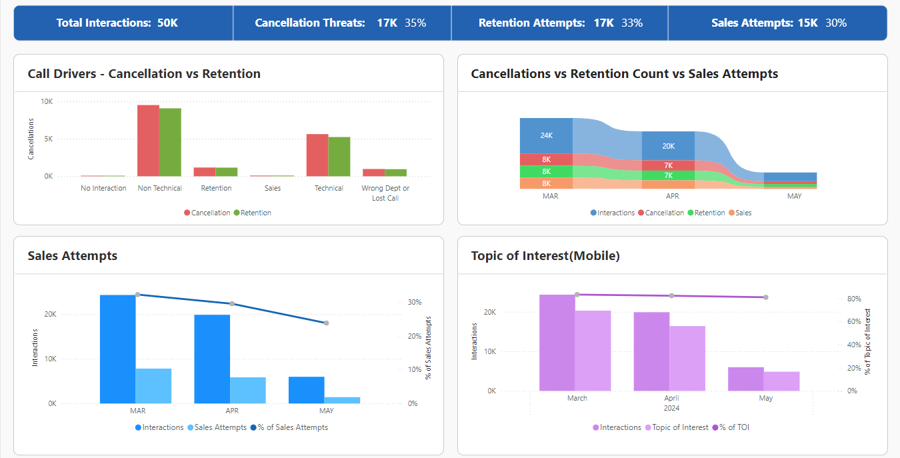
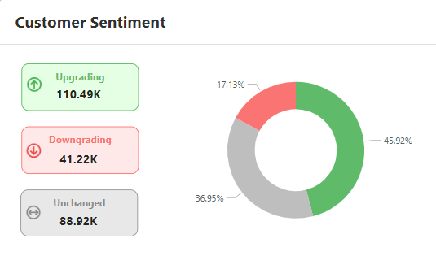
Dashboards for Deep Insights – Contd.
Insights across verticals
Call Driver Breakdown
Detailed Agent-wise Distribution
Sentiment Trends

Slide 8
ahegde@teamhgs.com
a.Shukla@teamhgs.com

