Slide 1
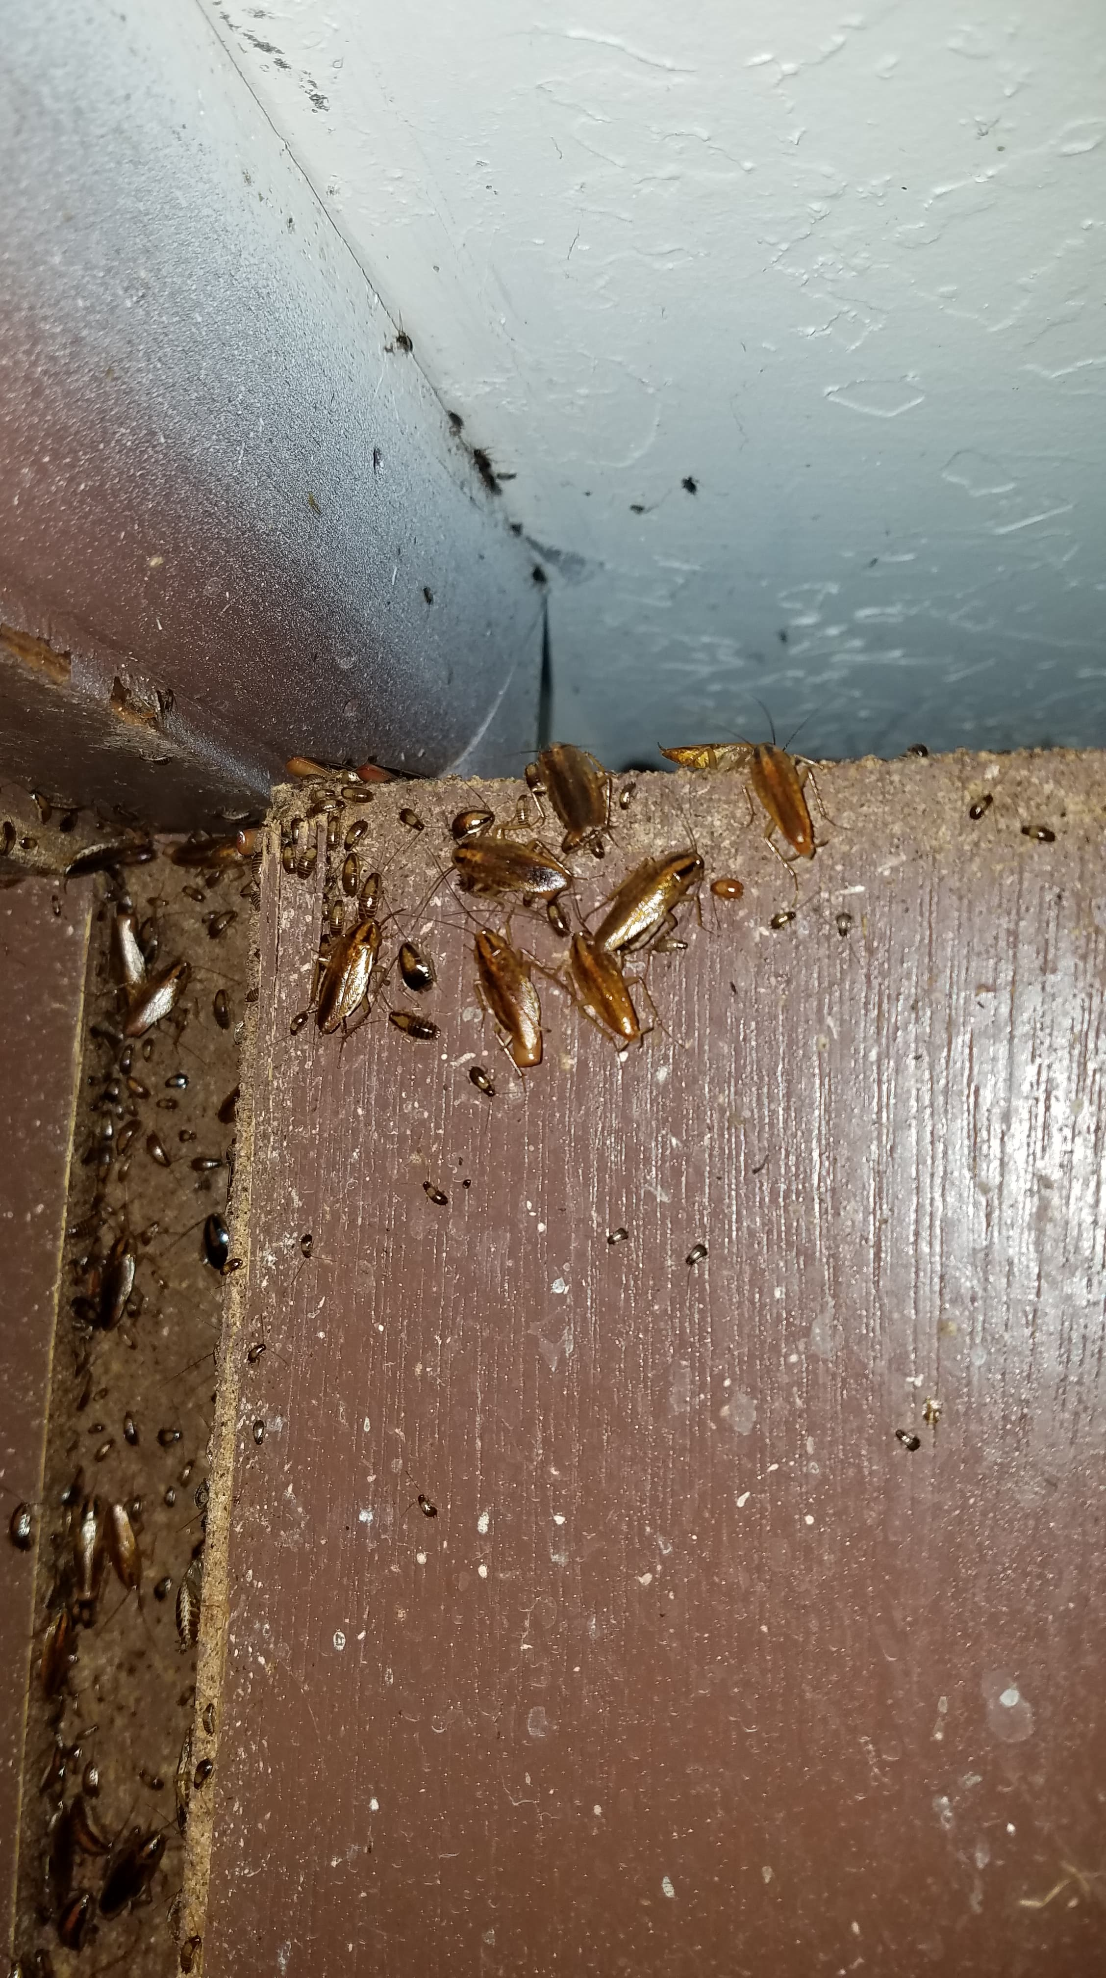
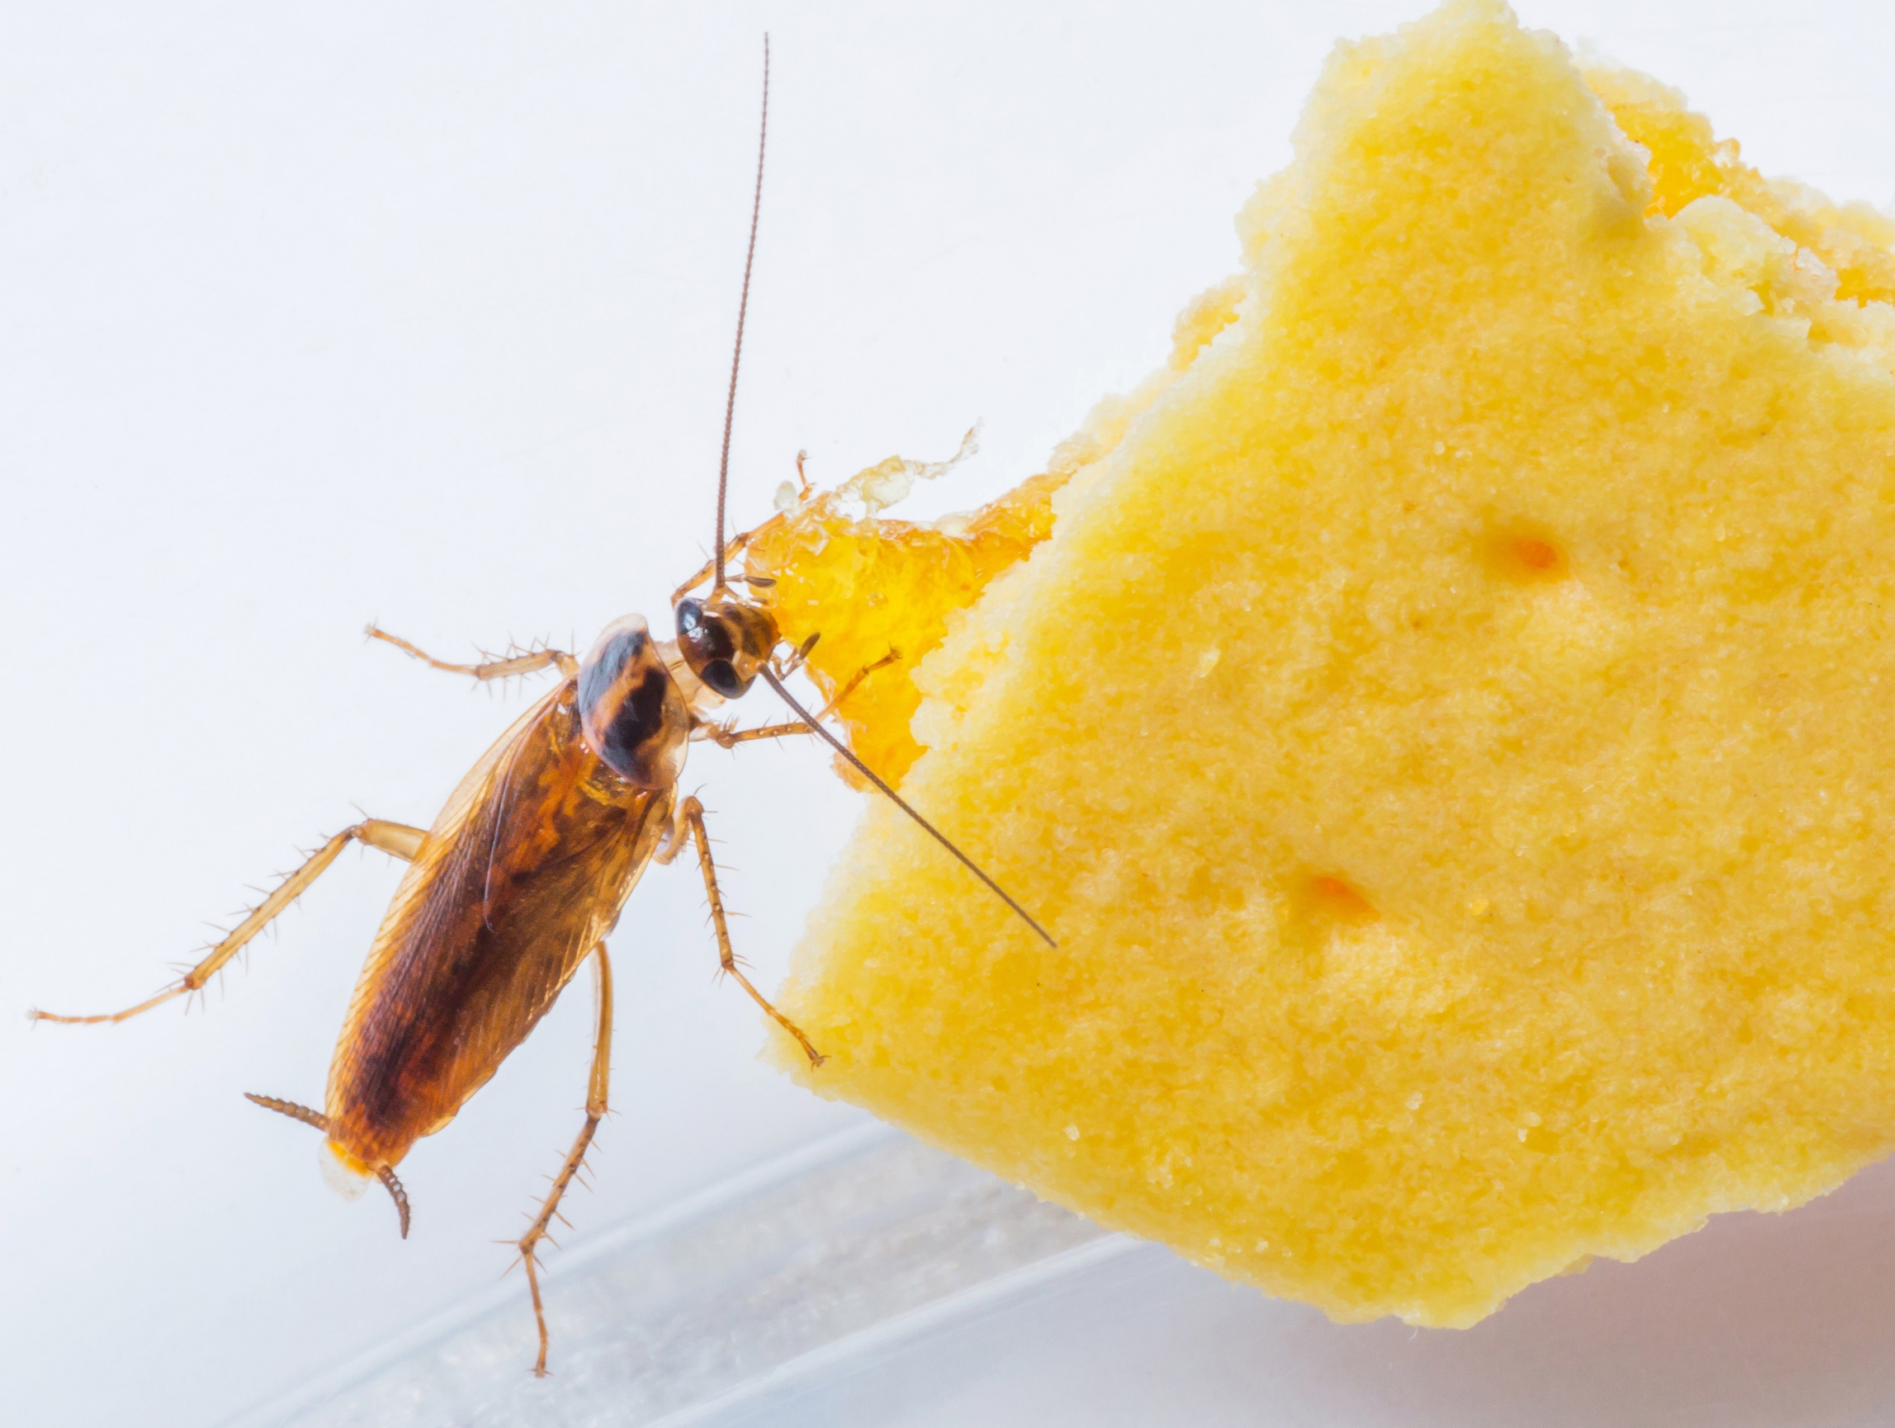

German Cockroach Management
Alvaro Romero, PhD.
Field Services Manager
alvaro.romero@envu.com
(575) 997-1840

Slide 2
Outline
Importance of cockroaches
Biology
Common Habitat
Inspection
Visual
Sticky traps
Treatment tools
Baits
Bait rotation
Aversion and resistance
Best practices for effective cockroach control
Notes:
The presentation highlights:
- The importance of cockroaches (why we should care about them).
- Basic aspects of their biology and behavior, including how they survive in indoor environments.
- Ways to detect infestations to begin planning a management program.
- Treatment options available for control and management.
- Basic concepts about aversion and insecticide resistance, which help explain why rotation programs are necessary.
- Finally, a quick review of best practices for carrying out an effective management program for German cockroaches.
---

Slide 3
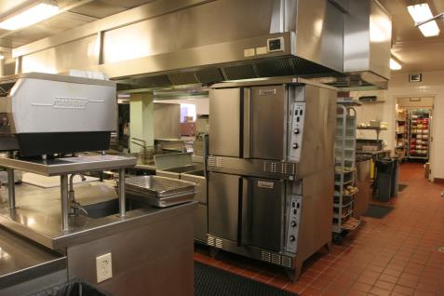
Why Cockroaches are Considered Pests?
Live in unsanitary conditions
  Garbage storage
  Sewage systems
  Septic tanks
Associated with pathogens and allergens
Produce anxiety and STRESS
Notes:
1. Cockroaches are omnivorous, meaning they eat a variety of foods, particularly decomposing organic matter. This material can be found in:
- Garbage storage areas
- Sewage systems
- Septic tanks
This implies that there are many microorganisms in these areas that can be pathogenic to humans and animals.
2. The presence of cockroaches is unpleasant for many. Nobody wants to see or live with cockroaches.

Slide 4
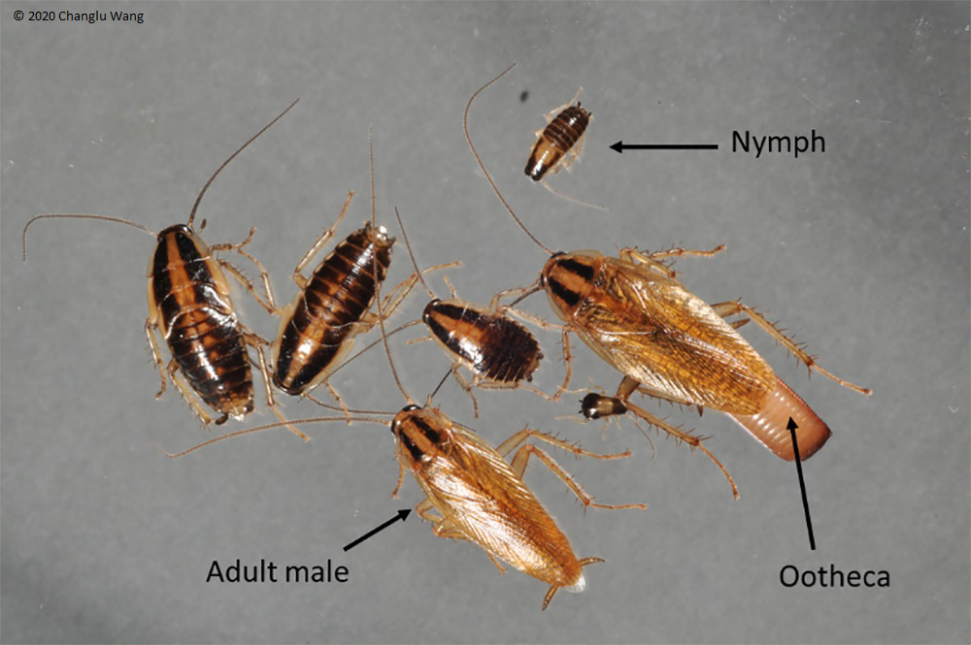
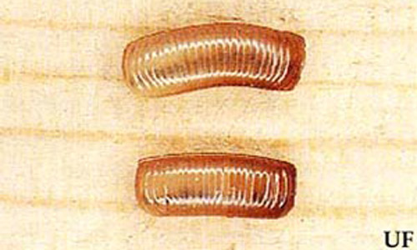

German Cockroach Biology
Adults: ~1/2” in length
Adults and nymphs with 2 dark “racing stripes”
Only need to mate once
Egg case: 1/4” in length
30-40 eggs per case
Females hold ootheca until or just before hatch.
Nymphs: emerge avg. of 28 days. 6-7 nymphal stages
Egg to Adult: avg. ~100 days
Adult lives ~200 days
10,000+ descendants per year
Notes:
The takeaway here is to understand
-What de different stages look like
-The reproductive capability of German cockroaches.
- A complete generations is produced
-In theory a male and female can produce over 10.000 cockroaches

Slide 5
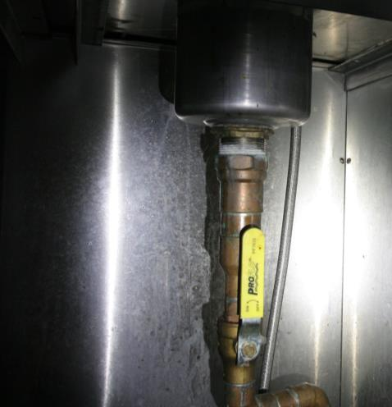
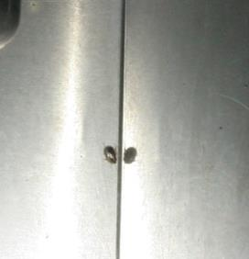
Where are they found?
World-wide distribution
Found in:
  Homes
  Apartments
  Supermarkets
  Food processing plants
  Restaurants
  Ships
  ANYWHERE HUMANS ARE
Notes:
German cockroaches are indoor pests. Therefore, they are commonly found in
-Homes
-Apartments
-Supermarkets
-Food processing plants
-Restaurants
-Ships
or anywhere where they find resources to survive

Slide 6
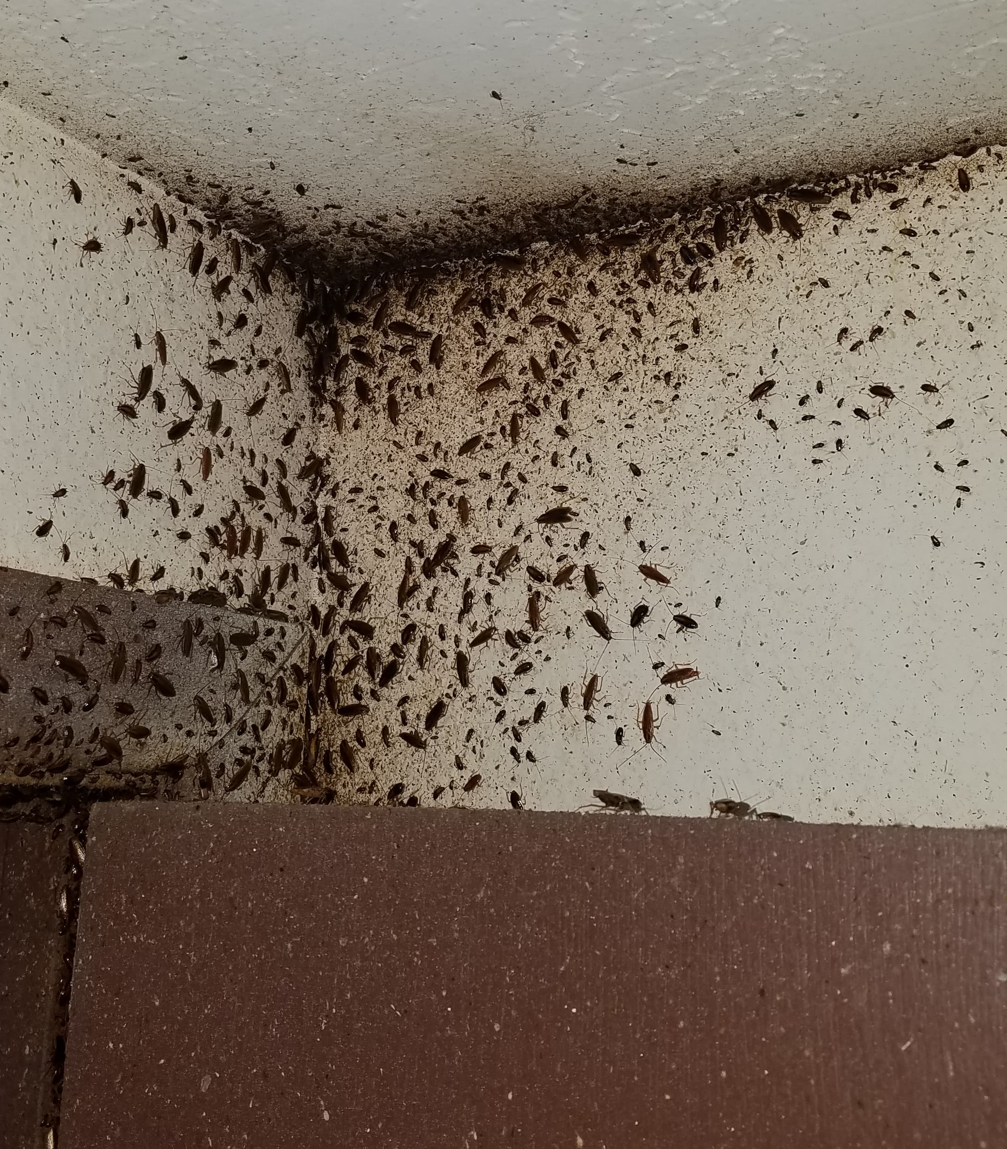
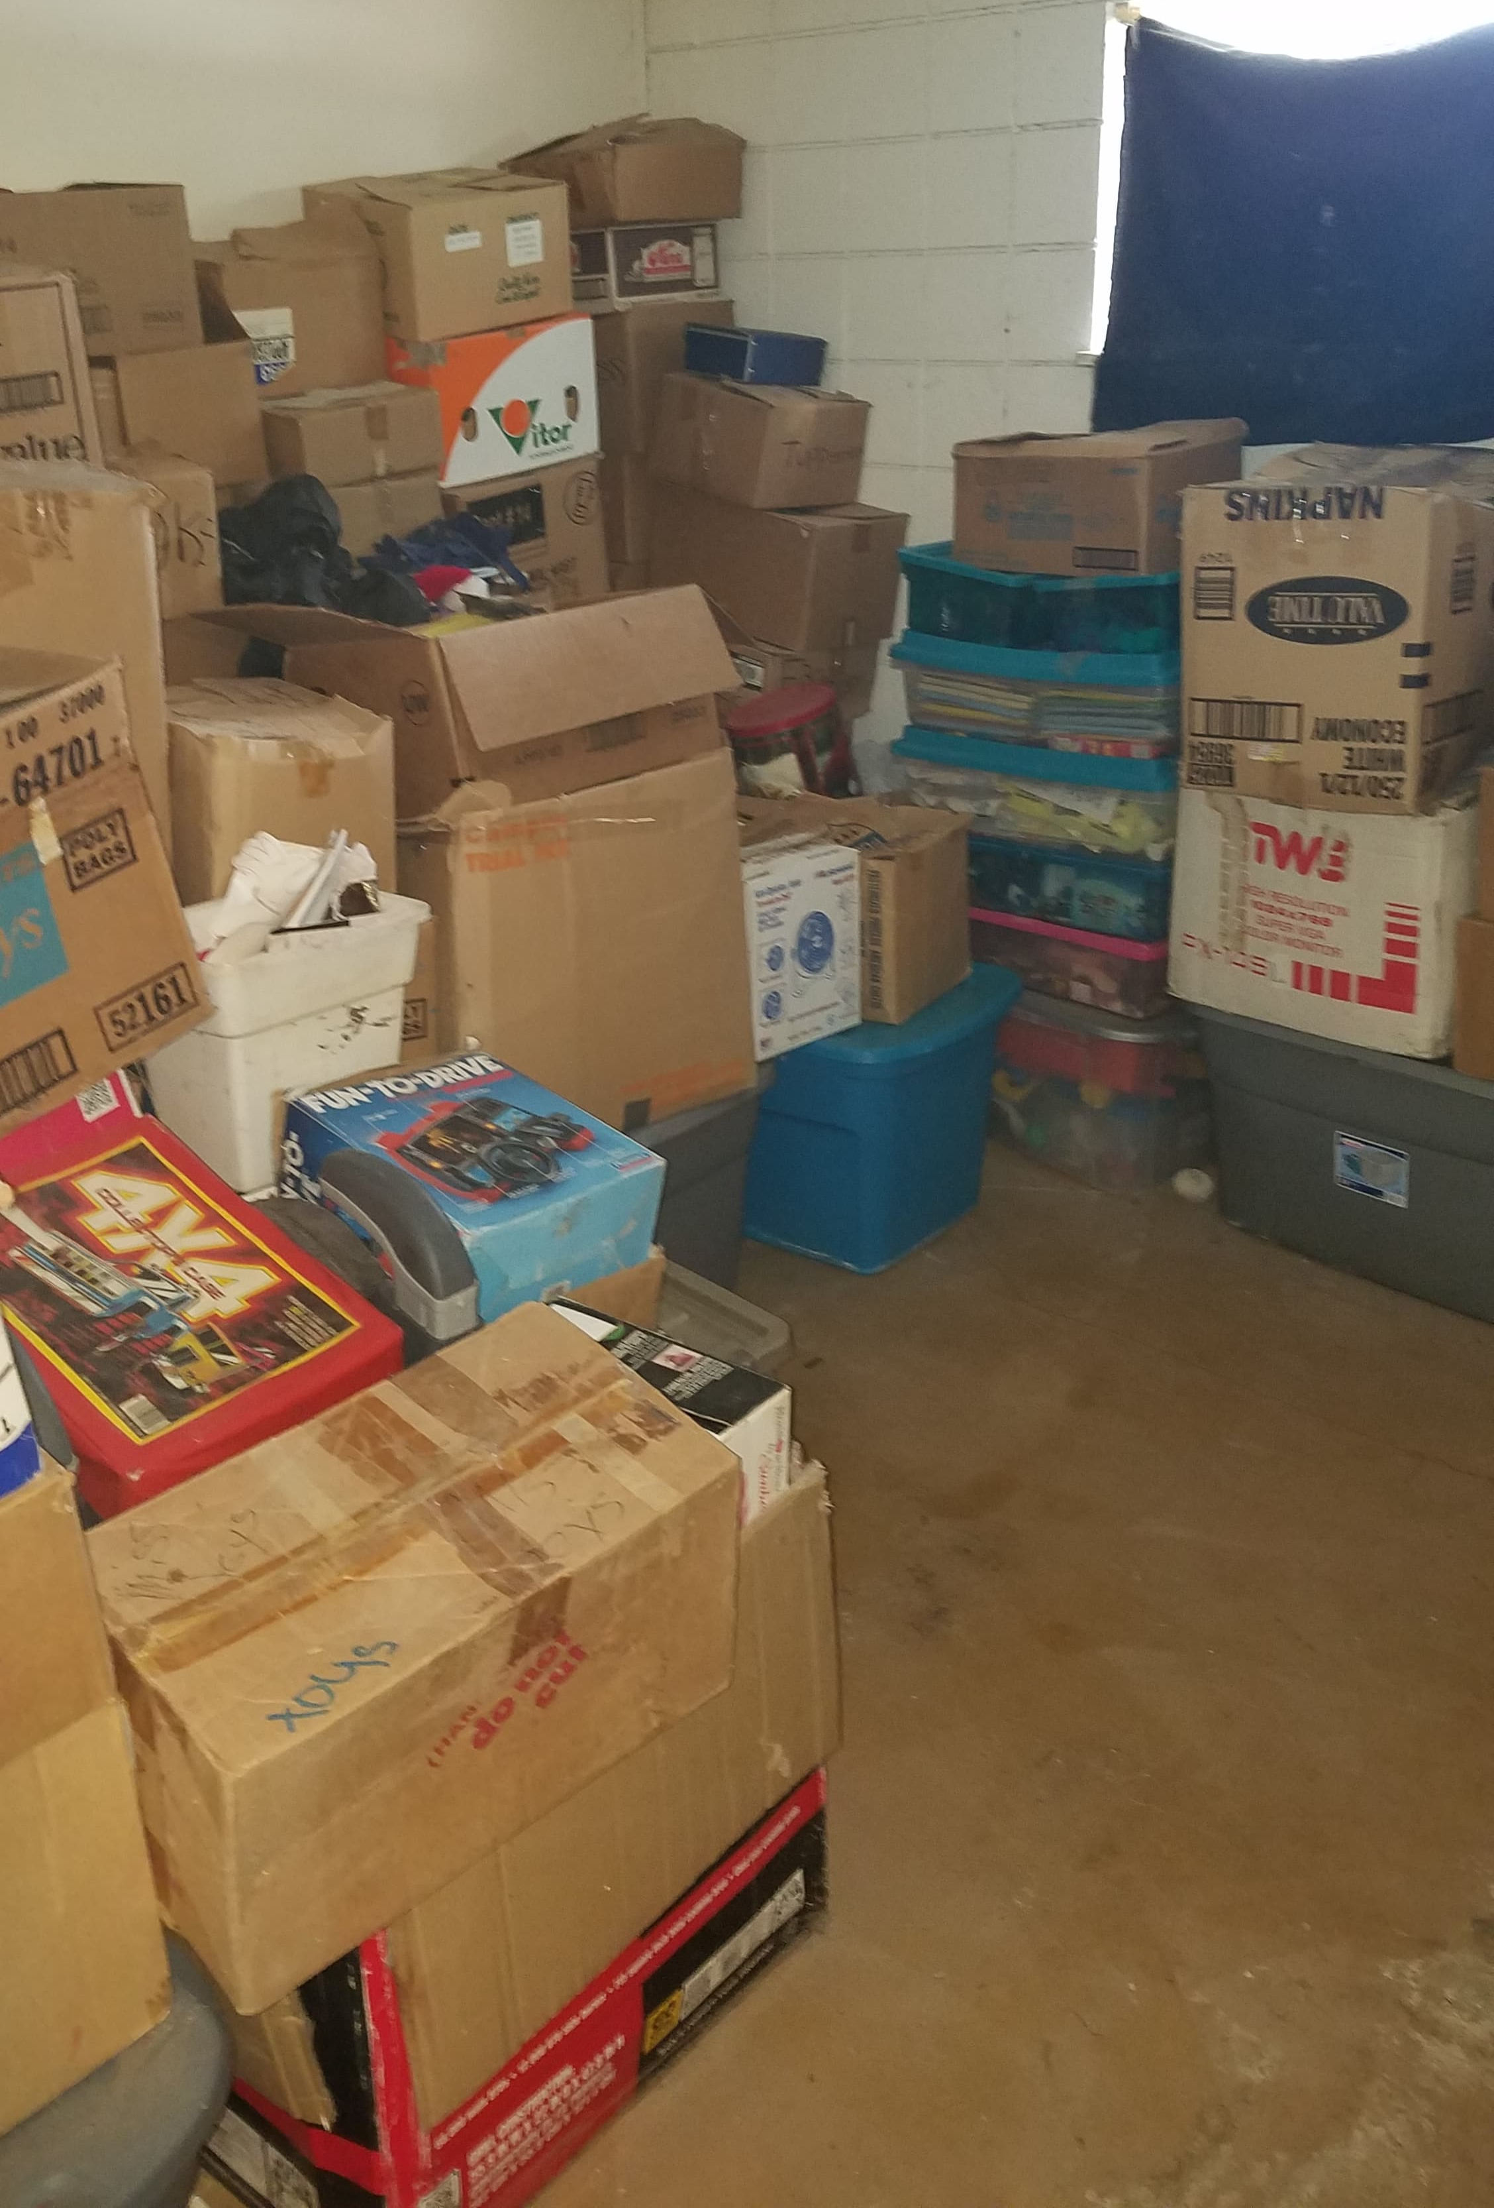
German Cockroach Habitat
Typically found in kitchens.
  Need food, shelter and daily access to water
  Poor sanitation = expansion of habitat!
Prefer wooden and paper materials
May be found in electrical equipment
Attracted to warmth.
Notes:
Kitchens are preferred areas for German cockroaches because they provide essential resources for survival:
- Food
- Water
- Shelter
Poor sanitation provides these resources.
Cockroaches hide in materials with rough surfaces, which offer better grip and reduce light exposure.
- Cockroaches remain hidden because they are typically averse to light (photophobic).
- However, in established infestations, cockroach pheromones can become more powerful, making it more common to see cockroaches during the daytime.

Slide 7
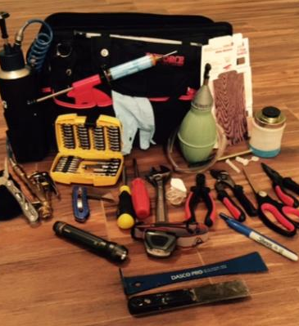
Inspection and treatment tools
Flashlights and headlamps
Gloves
Extra uniform(s)
Kneepads
Glue boards
Vacuum cleaner
Variety of dusters and tips
Flushing agents
Baits, bait stations, bait guns and plungers.
Notes:
Flushing agents help in low infestation situations where is hard to find them during the day.

Slide 8
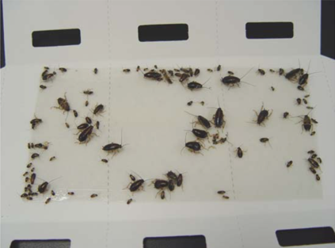
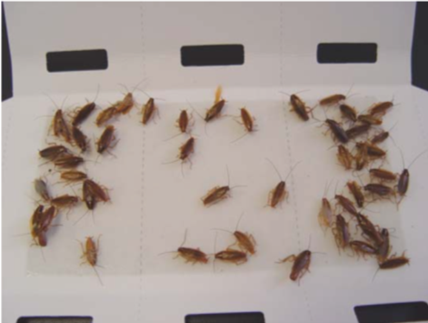
Glue Boards (sticky traps)
Low cost
Easy to use-point where to focus bait application
Good estimation of cockroach infestation levels
Place in corners, edges and against vertical surfaces
Many nymphs = Heavy infestation
Many adults = Likely hitchhikers
Notes:
Trapping could improve treatment efficacy. Place traps against walls and in corners, as cockroaches prefer to walk along edges. The life stages caught on the traps provide information about the “age of the infestation.” Abundant nymphs indicate an established population, while captures predominantly consisting of adults suggest a more recent infestation. Established infestations will require a more thorough inspection and more intensive baiting.

Slide 9
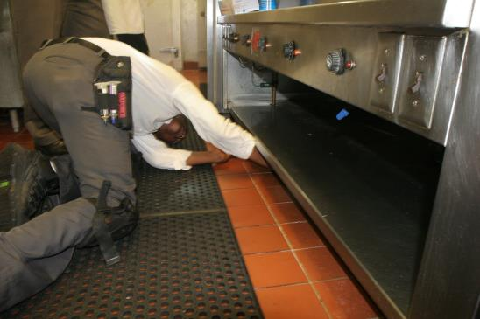
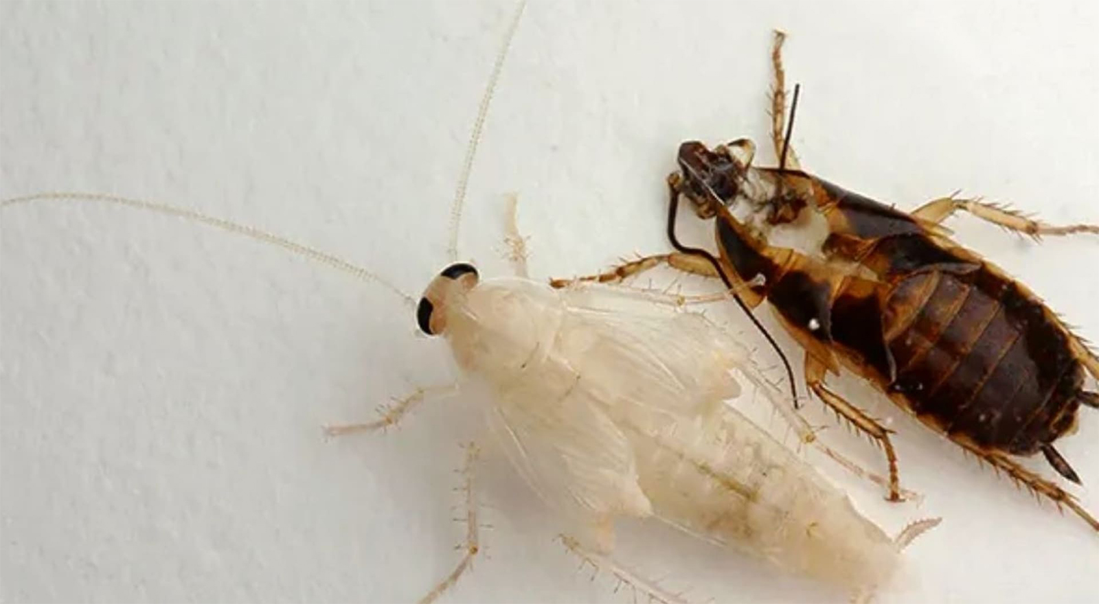
Where to Inspect (and bait)
Tend to hide and harbor near food and water sources
Look for cracks and crevices, and aggregations points with fecal spots, ootheca, skin sheds, dead cockroaches.
Cabinets under the kitchen sink
Drawers of kitchen cabinets
Around the stove and refrigerator
In heavy infestations, the inspection needs to be very thorough
Bathroom
Notes:
Goal of inspection: Identify the major activity spots of cockroaches and beginning placing baits, if time to get the work done is limited. Special attention should be given to areas with food and water resources, particularly in crevices and cracks.
1. Signs of cockroach infestation include:
- The actual insects
- Ootheca (egg cases), skin sheds, and dead insects
2. Inspections are primarily conducted through visual checks, but sticky traps are useful tools for:
- Detecting low levels of infestation
- Identifying high-activity spots of cockroaches
- Planning the amount of bait needed
---

Slide 10
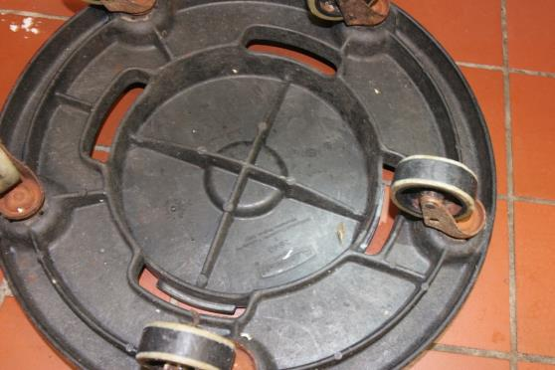
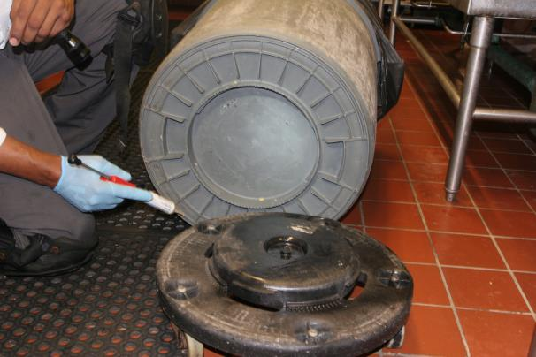
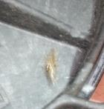
Take trash cans off their wheel bases to inspect for cockroaches
Notes:
Trash cans can be regularly cleaned, but the surrounding areas might not be, potentially containing enough detritus or organic matter to sustain cockroaches. These areas should be inspected, cleaned, and treated.

Slide 11
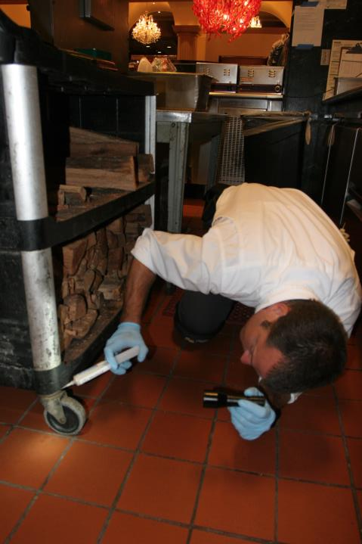
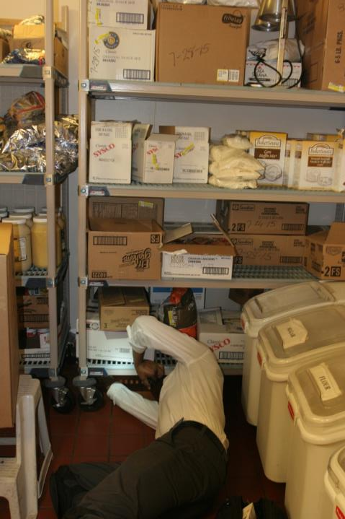
Movable equipment harbors and transports cockroaches
Notes:
Storage rooms are common entry points for cockroaches. Cockroaches often start their journey in these areas and can then spread to other locations

Slide 12
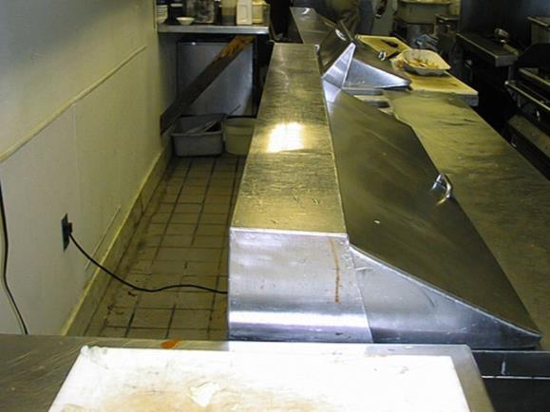
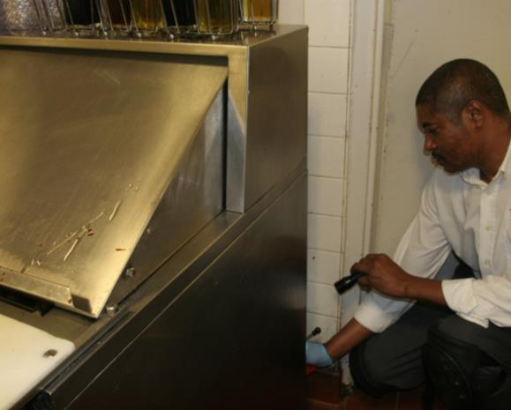
Move equipment to optimize inspection and bait placement
Notes:
Warmth is another factor that attracts cockroaches, as it can speed up their development. Equipment such as refrigerators, stoves, and other appliances generates heat and provides hiding places for cockroaches. Therefore, these items should be inspected by pulling them away from the walls, if possible.

Slide 13
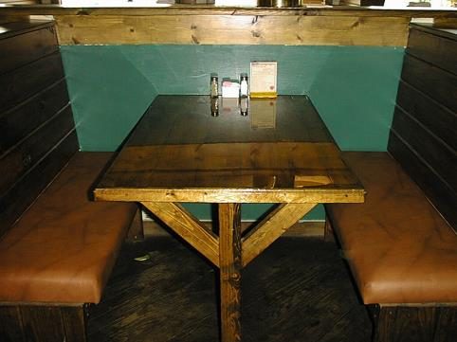
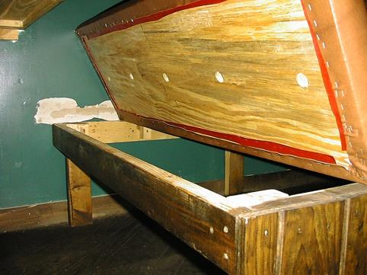
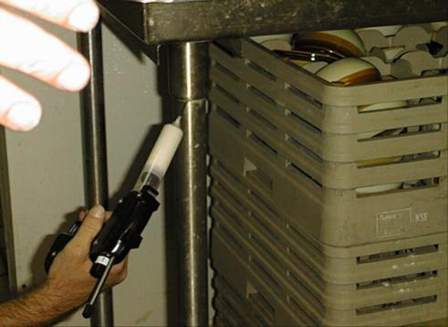
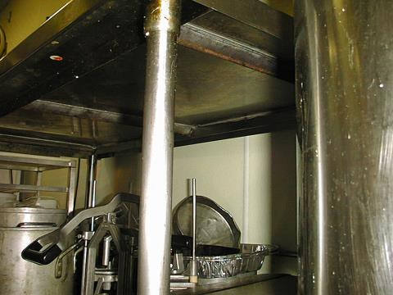
Notes:
During inspection, the PPM should look for potential areas that provide food detritus and hidden places. Examples of these places are shown on the pictures. Baiting these areas are key for a successful German cockroach control

Slide 14
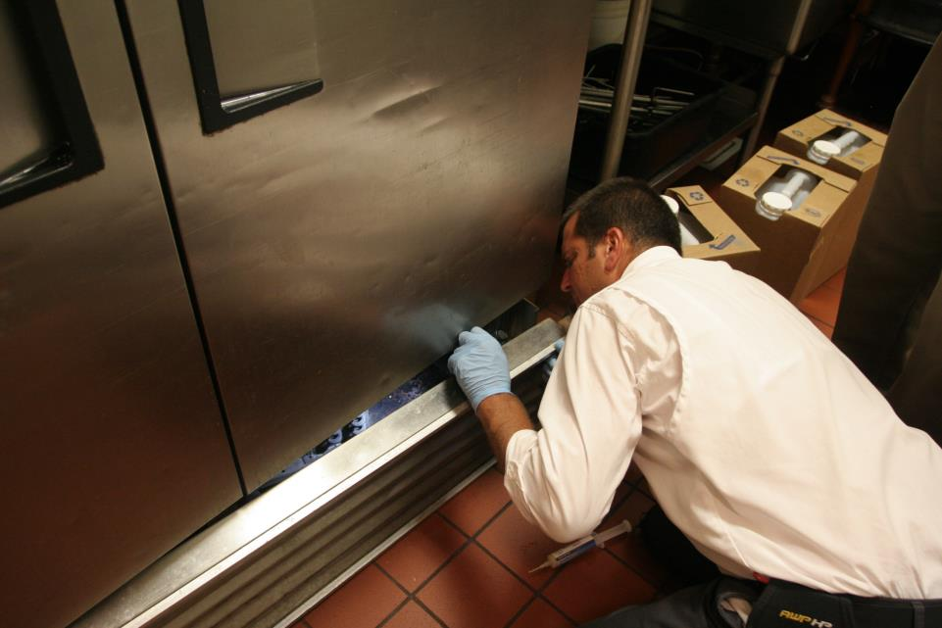
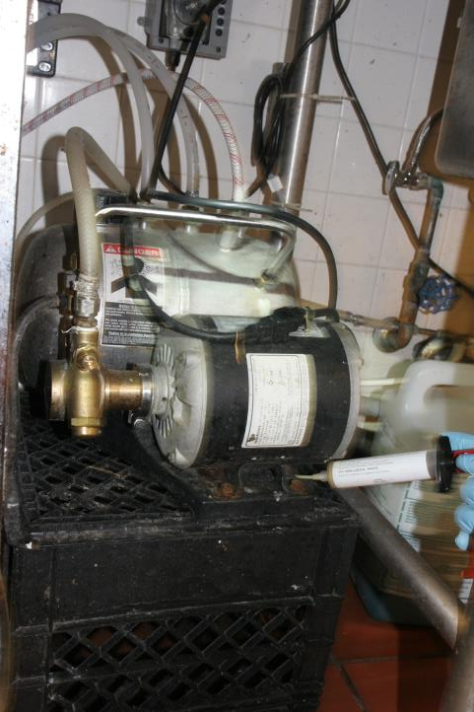
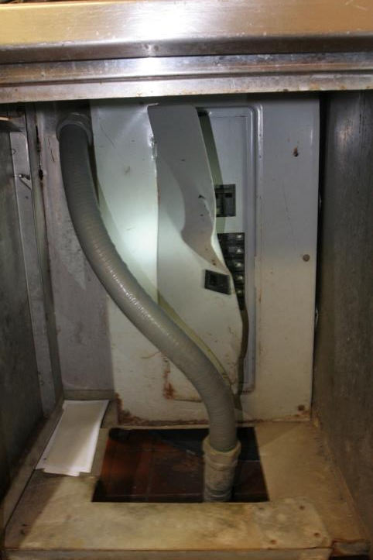
Take covers off to inspect and bait inside electrical housings
No liquids near electrical panels!
Notes:
The bottom of this fridge is a suitable place for cockroaches to hide and develop. Removing the cover will facilitate both the detection of cockroaches and the application of bait treatment

Slide 15
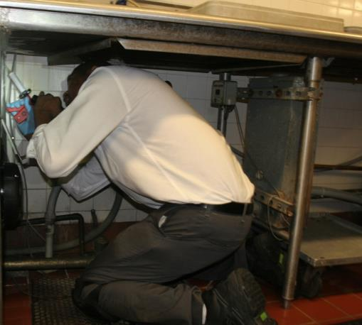
How Does the Expert Bait?
Estimates infestation level
Uses calibrated bait gun
Applies bait strategically

Slide 16
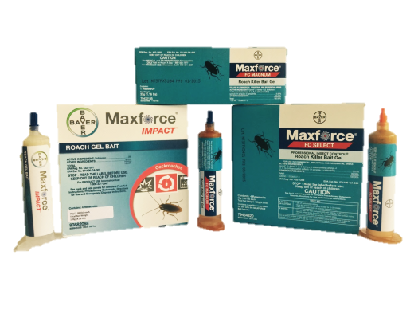
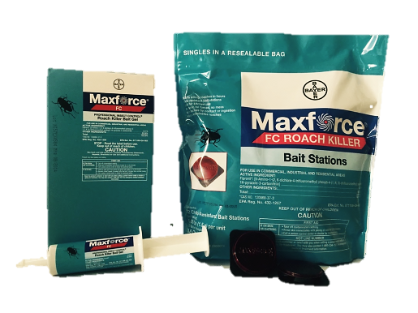
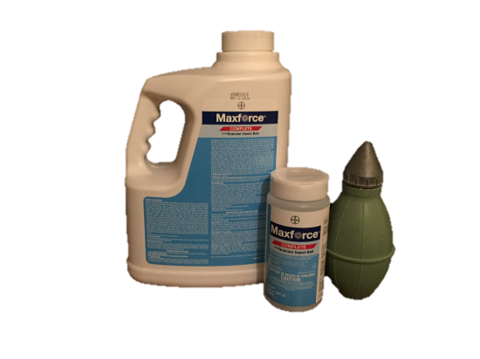
Which Baits are in the Expert’s Truck?

Slide 17
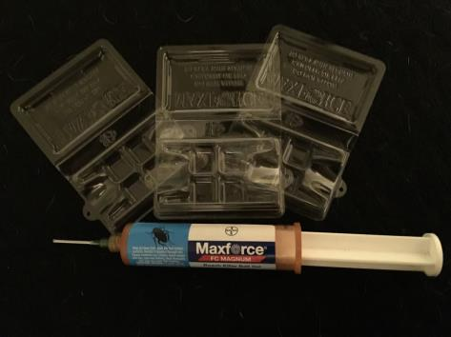
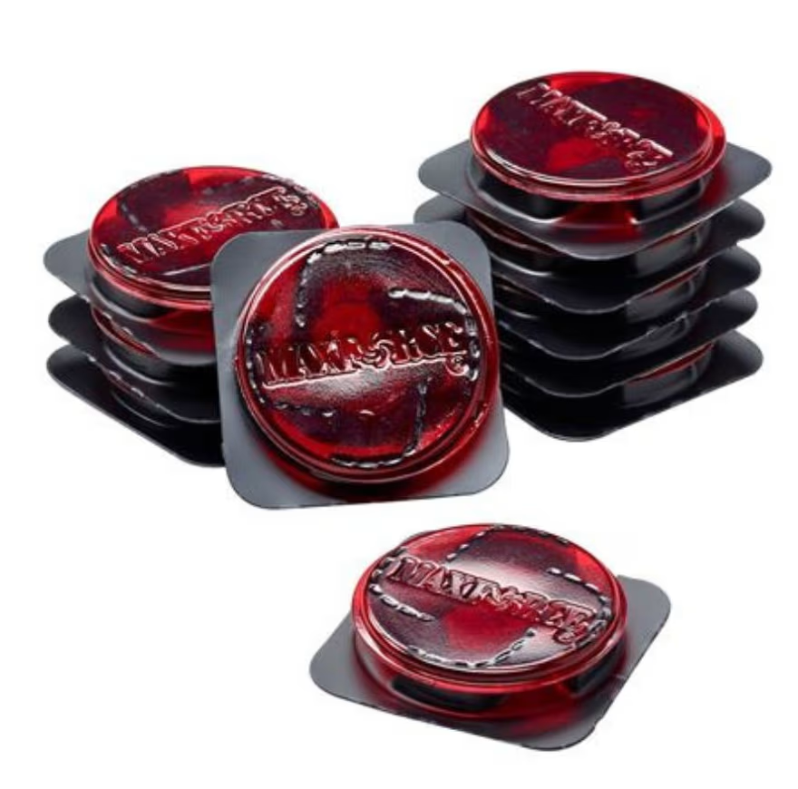
Where Does the Expert Inspect and Bait?
Place Maxforce FC Magnum into Maxforce Refillable
Bait Stations
Notes:
Bait stations are an effective tool for cockroach control for several reasons:
1. Bait stations attract cockroaches to a specific location where they consume the bait. This helps to target the cockroaches directly and can be more effective than general insecticides. It is important here identify key places for station placement
2. Cockroaches are typically nocturnal and avoid light. Bait stations can be placed in hidden or less accessible areas where cockroaches are likely to hide, making it easier to target them without disturbing their habitat.
3. Bait stations are designed to minimize exposure to humans and pets. The bait is contained within a sealed unit, reducing the risk of accidental contact. This is also important in food-preparation areas
6.
By using bait stations, you can improve control of cockroach populations in certain sensitive areas for cockroach control.

Slide 18
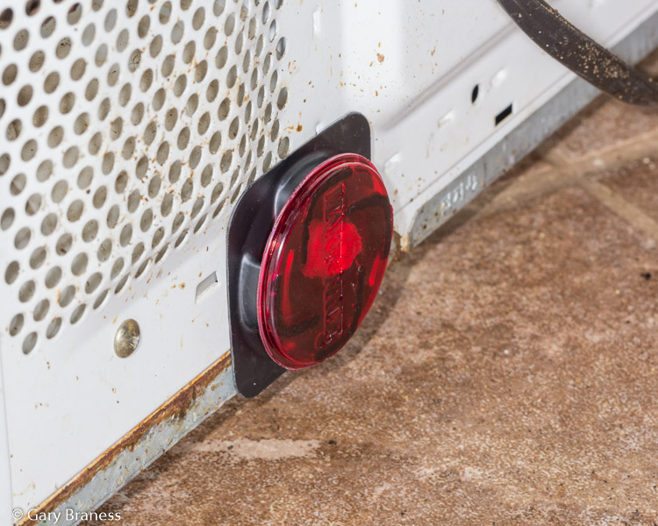
Where To Apply Bait Stations
Place where cockroaches have been seen or hide
  Adjacent to voids or cracks and crevices
  In corners
  Behind and under cupboards
  Near infested foodstuffs
Use on vertical surfaces by peeling off the protective strip to expose adhesive
Photo by Gary Braness
Notes:
Its also important to place bait stations close to cockroach harborages or in areas where cockroaches forage. Tips listed in slide.

Slide 19
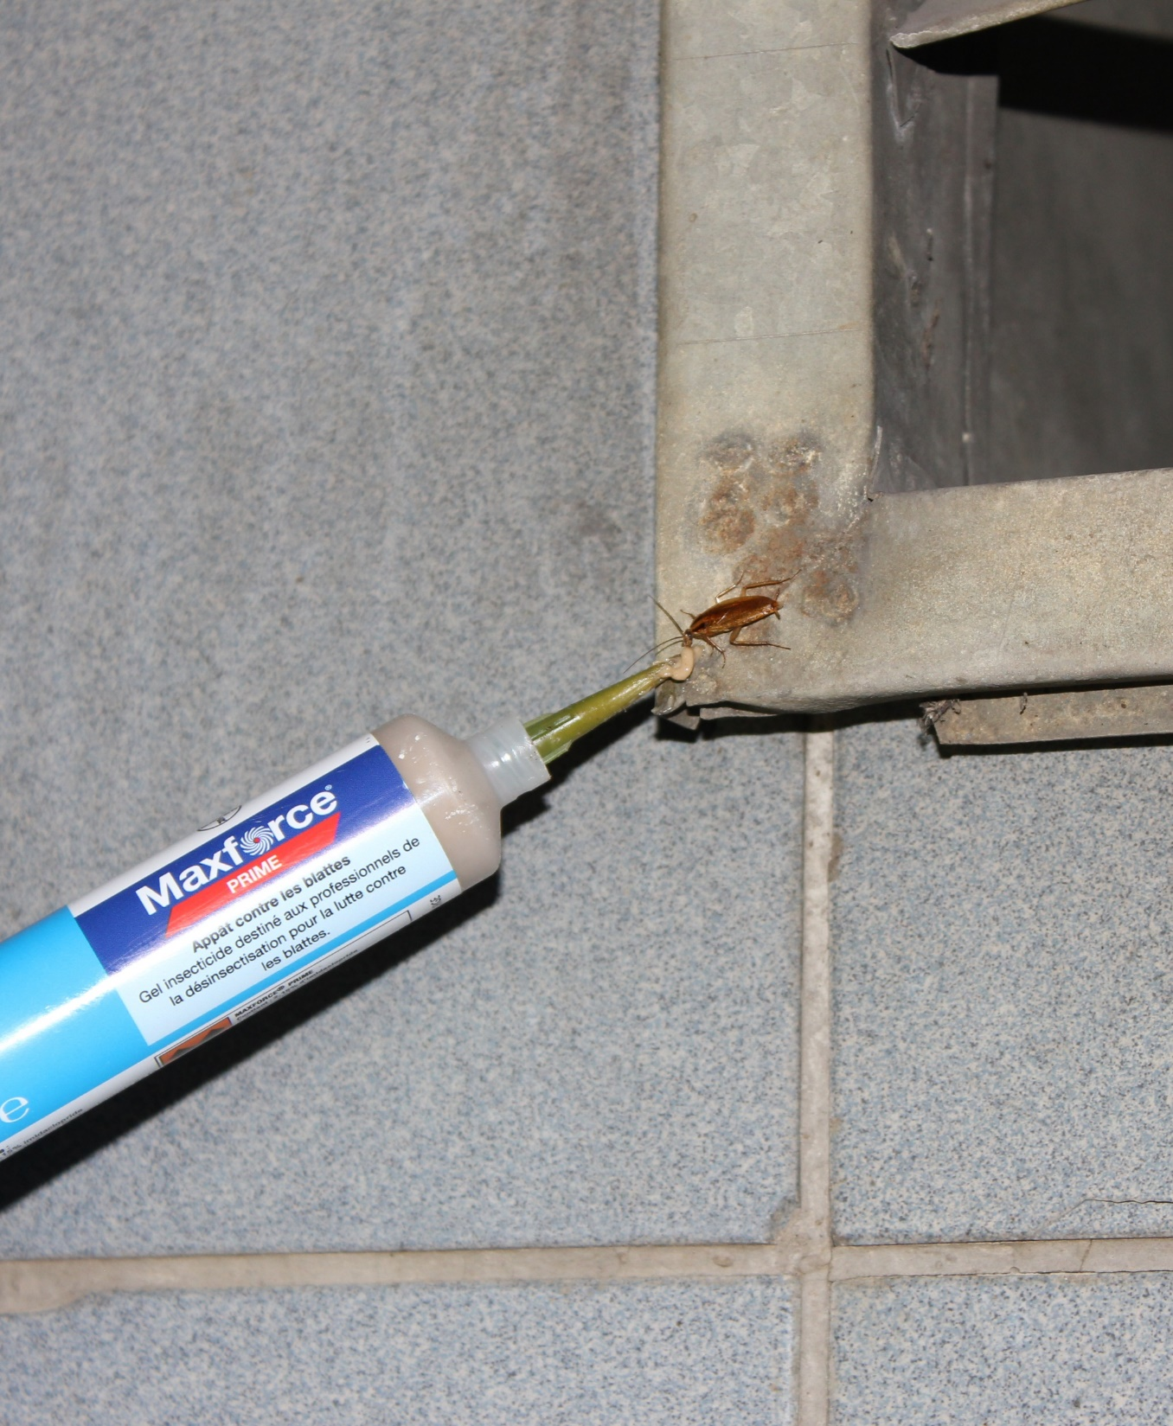
German
Cockroaches
Baiting
Notes:
Photo by Josh Shoemaker

Slide 20
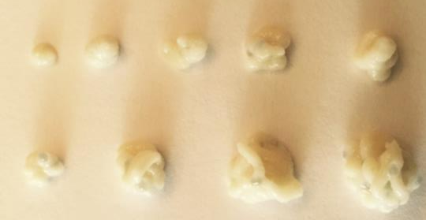
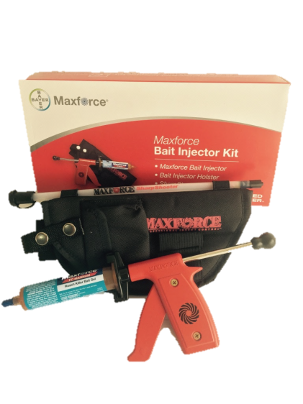
Proper Baiting
Regularly uses a bait gun
Needs to know how to calibrate bait guns
Different setting = Different amount
Notes:
Bait gun is an option for accurate bait delivery

Slide 21
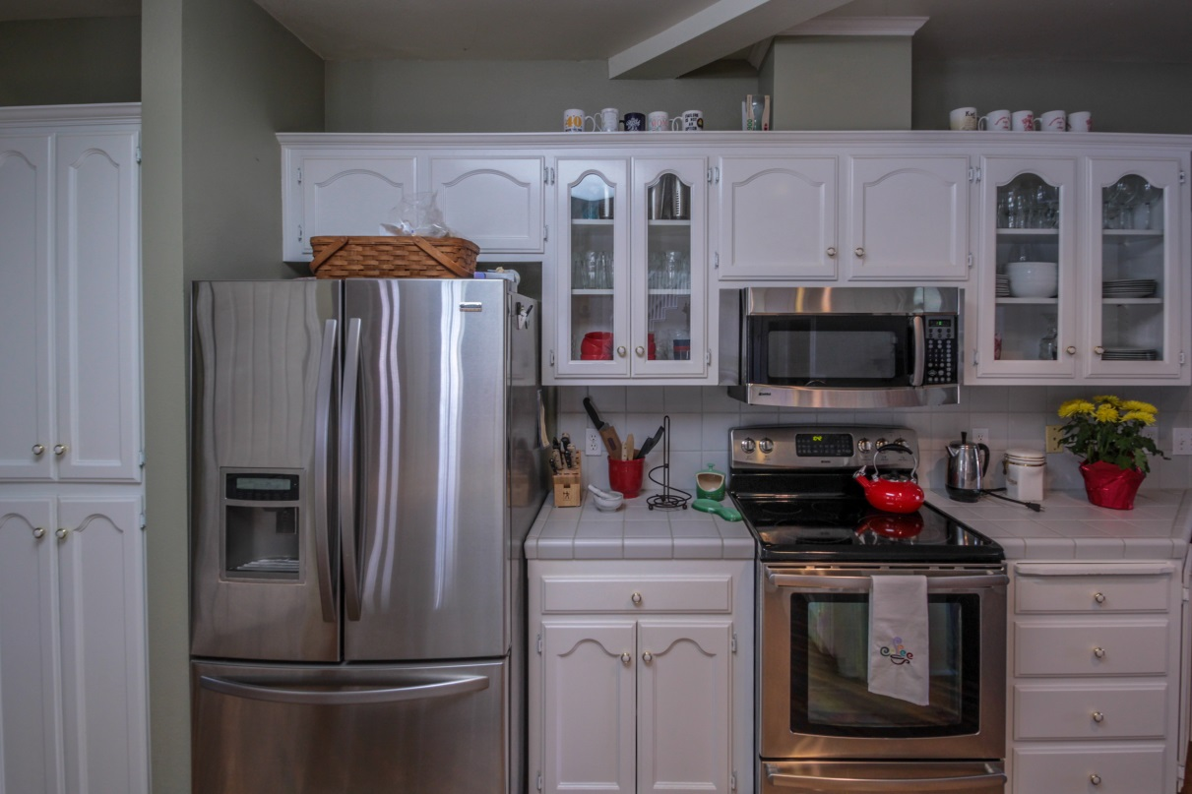
How Much Bait to Use?
Rates of bait use vary depending on the size of the area and the severity of the infestation.
Photo by Gary Braness
Notes:
Recall the discussion on sticky traps and inspections regarding determining infestation severity.

Slide 22
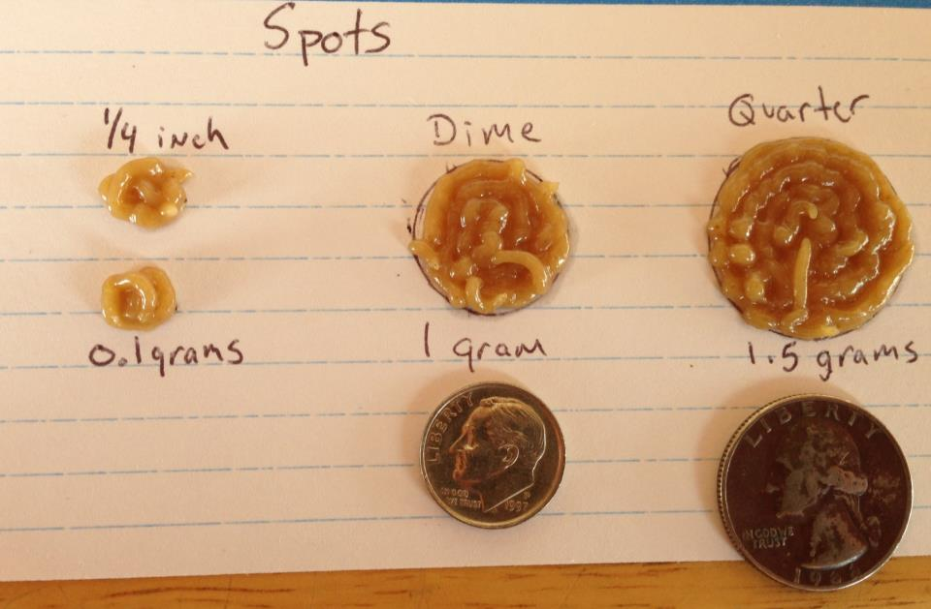
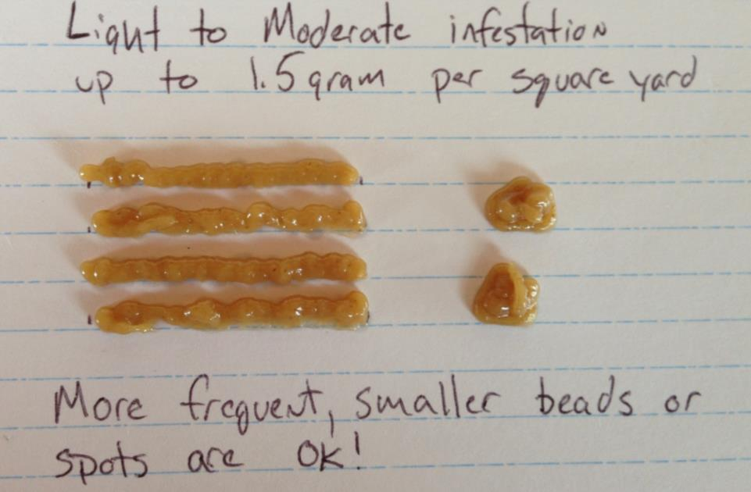
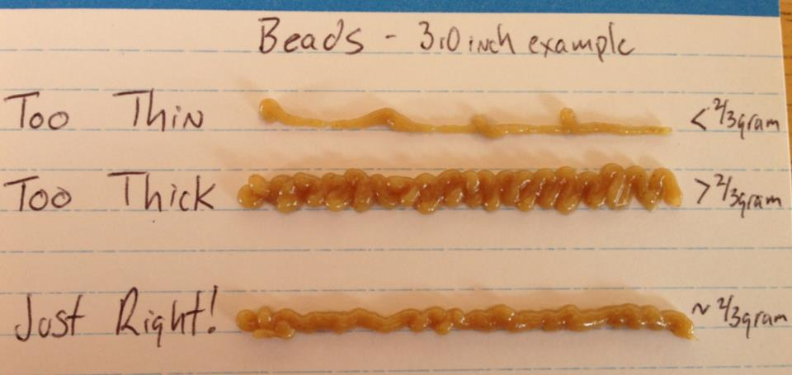
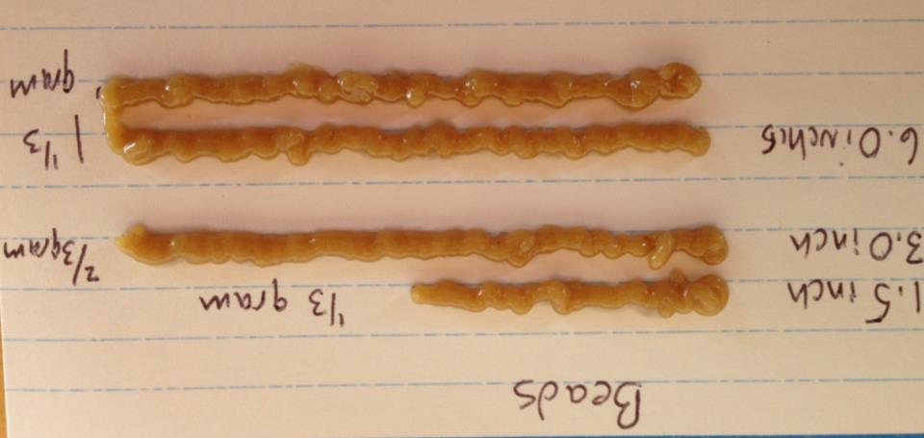
What Does the Label Say for Bait Application?
Notes:
Bait as many spots or beads as possible to increase likelihood of roaches to find it and get control.
Double the application rate (3g per square yard) to control severe infestations
For maintenance use 0.75 g

Slide 23
Proper Gel Placement
BEST GEL PLACEMENT SIZE
¼ to ½ Gram
SPOT
1 gram is about the size of a dime
BEAD
Approximately 3” long bead is 2/3 gram
See Maxforce Bait Placement Guide
Notes:
Smaller (1/4-1/2 g), more frequent bait placements work better than fewer, larger placements.
Both spots or beads are acceptable as long as they are not larger >2/3-1g each

Slide 24

Following the Label (Beads)
Photo and illustration by Laura Remmen

Slide 25
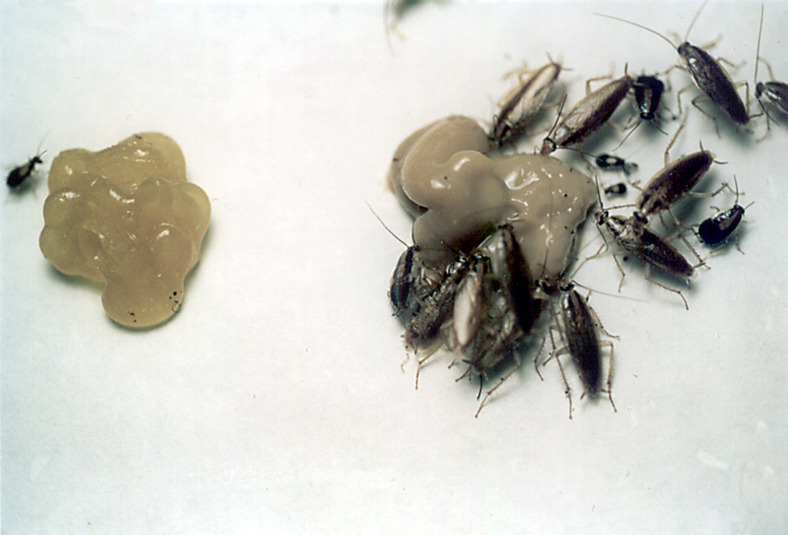
Bait aversion in German cockroaches
  Occur when the same bait is continuously used
  Some cockroach populations develop the ability to associate eating certain sugars in the bait with harmful effects
  These are reasons to rotate bait formulations that use different types of sugars.
  Glucose
  Jelly
  Peanut
  Butter
BES Photo
Notes:
Behavioral resistance is expressed when insects in a population stop feeding on a bait because of food ingredients in the bait. It is commonly referred to as bait aversion.

Slide 26
Notes:
To avoid bait aversion (specially fructose and sugar components), theory indicates that the relate finding fructose with high frequency with the risk to be killed by the a.i… and/or resistance is to rotate the bait every 3-4 months.

Slide 27
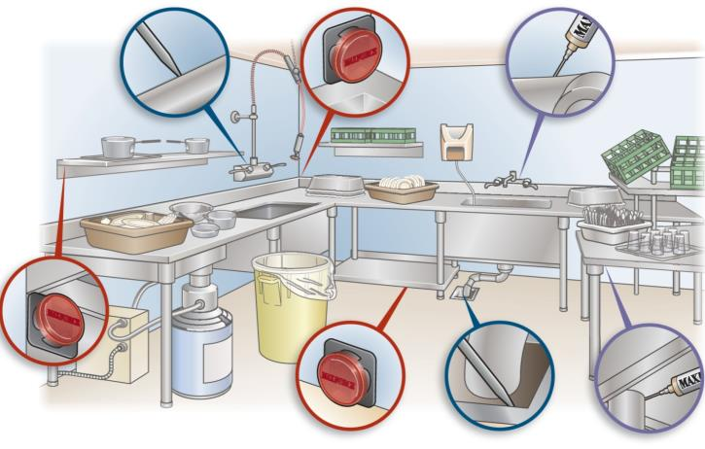
Best practices for effective
German cockroach control
Commercial Treatment Guide
Dishwashing Station
Record and report sanitation issues and report ongoing progress to the correct person.

Slide 28
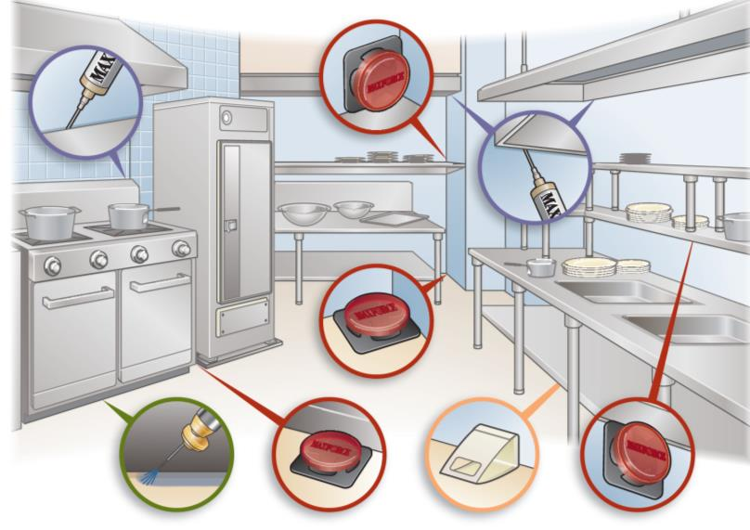
Best practices for effective
German cockroach control
Commercial Treatment Guide
Pot & Pan Storage

Slide 29
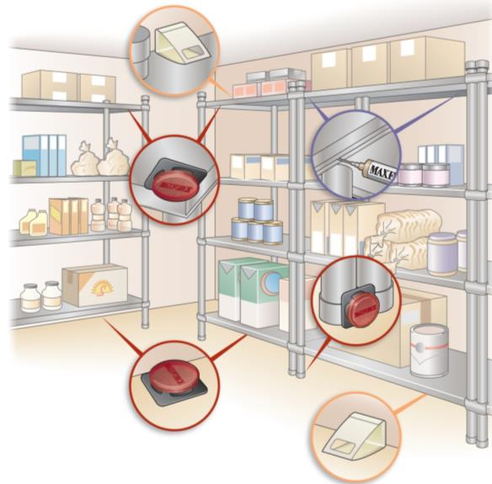
Best practices for effective
German cockroach control
Food Storage Area
Cockroaches are normally brought into an account through incoming goods.
In food storage areas, place bait stations under storage racks and to the underside of shelves.

Slide 30
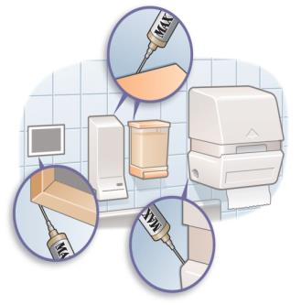
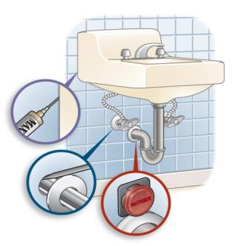
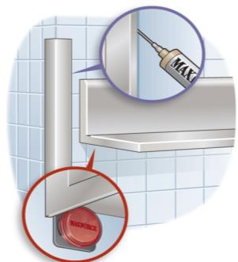
Best practices for effective
German cockroach control
Miscellaneous Areas
Wall Fixtures
Free-Standing Sink
Steel Corners

Slide 31


Avoid Contamination!
Don’t apply liquids over baits!
Notes:
Some liquid sprays might have repellent effects making the bait less attractive to cockroaches

Slide 32

Summary/Recommendations
Understands biology of pests
Refined inspection and monitoring
Wise product usage
Rotate
Avoids contamination
Bait hollow legs and wheels of kitchen equipment

Slide 33

Thank you for your attention!

